Slide 1
Understanding Datasets

Slide 2
Need of understanding dataset
to understand the incoming data and create basic understanding about the nature and quality of the data
helps to select and then how to apply the model
The first step in machine learning activity starts with data
In case of supervised learning, it is the labelled training data set followed by test data which is not labelled
In case of unsupervised learning, there is no question of labelled data but the task is to find patterns in the input data
A thorough review and exploration of the data is needed to understand the type of the data, the quality of the data and relationship between the different data elements.

Slide 3
Need of understanding dataset
Based on that, multiple pre-processing activities may need to be done on the input data before we can go ahead with core machine learning activities
Following are the typical preparation activities done once the input data comes into the machine learning system:
  Understand the type of data in the given input data set.
  Explore the data to understand the nature and quality.
  Explore the relationships amongst the data elements, e.g. inter-feature relationship.
  Find potential issues in data.
  Do the necessary remediation, e.g. impute missing data values, etc., if needed.
  Apply pre-processing steps, as necessary.

Slide 4
Need of understanding dataset
Once the data is prepared for modelling, then the learning tasks start off. As a part of it, do the following activities:
  The input data is first divided into parts – the training data and the test data (called holdout). This step is applicable for supervised learning only.
  Consider different models or learning algorithms for selection.
  Train the model based on the training data for supervised learning problem and apply to unknown data. Directly apply the chosen unsupervised model on the input data for unsupervised learning problem.

Slide 5
Need of understanding dataset
After the model is selected, trained (for supervised learning), and applied on input data, the performance of the model is evaluated.
Based on options available, specific actions can be taken to improve the performance of the model, if possible.

Slide 6
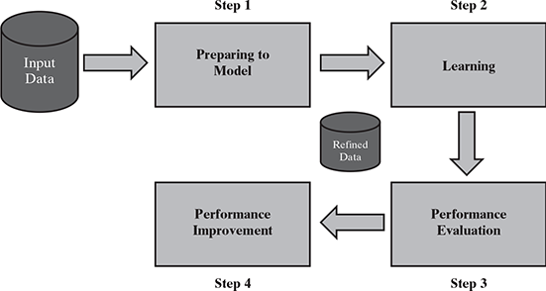
Detailed process of machine learning

Slide 7
BASIC TYPES OF DATA IN MACHINE LEARNING
A data set is a collection of related information or records.
Examples
  data set on students in which each record consists of information about a specific student.
  data set on student performance which has records providing performance, i.e. marks on the individual subjects.
Each row of a data set is called a record.
Each data set also has multiple attributes, each of which gives information on a specific characteristic.
Attributes can also be termed as feature, variable, dimension or field.

Slide 8
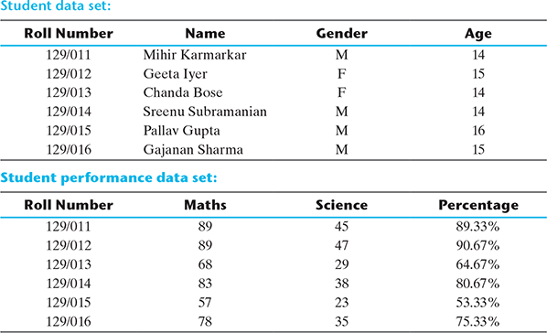
Examples of data set having four dimensional data space

Slide 9
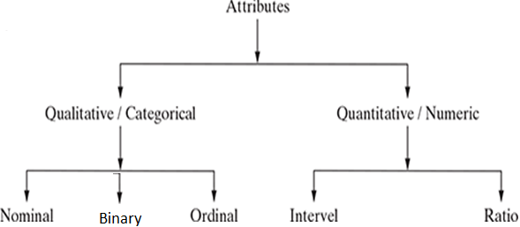
Data Types
Data can broadly be divided into following two types:
  Qualitative data
  Quantitative data

Slide 10
Qualitative data
Qualitative data is also called categorical data
Qualitative data can be further subdivided into two types as follows:
  Nominal data
  Binary data
  Ordinal data

Slide 11
Nominal data
Nominal data is one which has no numeric value, but a named value.
Nominal values cannot be quantified.
Examples of nominal data are
  Blood group: A, B, O, AB, etc.
  Nationality: Indian, American, British, etc.
  Gender: Male, Female, Other
A special case of nominal data is when only two labels are possible, e.g. pass/fail as a result of an examination.
  This sub-type of nominal data is called ‘dichotomous’.

Slide 12
Nominal data
mathematical operations such as addition, subtraction, multiplication, etc. cannot be performed on nominal data.
statistical functions such as mean, variance, etc. can also not be applied on nominal data.
However, a basic count is possible.
  So mode, i.e. most frequently occurring value, can be identified for nominal data.

Slide 13
Binary Data
A binary attribute is a nominal attribute with only two categories or states: 0 or 1,
  where 0 typically means that the attribute is absent, and 1 means that it is present.
  Example- Smoker describing a patient who smokes (1) or who does not smokes (0)
Binary attributes are referred to as Boolean if the two states correspond to true and false.
A binary attribute is symmetric
  if both of its states are equally valuable and carry the same weight; that is, there is no preference on which outcome should be coded as 0 or 1.
  One such example could be the attribute gender having the states male and female.
A binary attribute is asymmetric
  if the outcomes of the states are not equally important, such as the positive and negative outcomes of a medical test for HIV.
  By convention, we code the most important outcome, which is usually the rarest one, by 1 (e.g., HIV positive) and the other by 0 (e.g., HIV negative)

Slide 14
Ordinal data
Ordinal data in addition to possessing the properties of nominal data, can also be naturally ordered.
they can be arranged in a sequence of increasing or decreasing value so that we can say whether a value is better than or greater than another value.
Examples of ordinal data are
  Customer satisfaction: ‘Very Happy’, ‘Happy’, ‘Unhappy’, etc.
  Grades: A, B, C, etc.
  Hardness of Metal: ‘Very Hard’, ‘Hard’, ‘Soft’, etc.

Slide 15
Ordinal data
Like nominal data, basic counting is possible for ordinal data.
Hence, the mode can be identified.
Since ordering is possible in case of ordinal data, median, and quartiles can be identified in addition.
Mean can still not be calculated.

Slide 16
Quantitative data
Quantitative data relates to information about the quantity of an object – hence it can be measured.
For example, if we consider the attribute ‘marks’, it can be measured using a scale of measurement.
Quantitative data is also termed as numeric data.
There are two types of quantitative data:
  Interval data
  Ratio data

Slide 17
Interval-Scaled data
Interval data is numeric data for which not only the order is known, but the exact difference between values is also known.
An ideal example of interval data is Celsius temperature.
The difference between each value remains the same in Celsius temperature.
For example, the difference between 12°C and 18°C degrees is measurable and is 6°C as in the case of difference between 15.5°C and 21.5°C.
Other examples include date, time, etc.

Slide 18
Interval-Scaled data
For interval data, mathematical operations such as addition and subtraction are possible.
For that reason, for interval data, the central tendency can be measured by mean, median, or mode.
Standard deviation can also be calculated.

Slide 19
Interval-Scaled data
However, interval data do not have something called a ‘true zero’ value.
For example, there is nothing called ‘0 temperature’ or ‘no temperature’.
Hence, only addition and subtraction applies for interval data.
The ratio cannot be applied.
This means, we can say a temperature of 40°C is equal to the temperature of 20°C + temperature of 20°C.
However, we cannot say the temperature of 40°C means it is twice as hot as in temperature of 20°C.

Slide 20
Ratio-SCALED data
Ratio data represents numeric data for which exact value can be measured.
Absolute zero is available for ratio data.
Also, these variables can be added, subtracted, multiplied, or divided.
The central tendency can be measured by mean, median, or mode and methods of dispersion such as standard deviation.
Examples of ratio data include height, weight, age, salary, etc.

Slide 21
Another way to categorize data
attributes can also be categorized into types based on a number of values that can be assigned.
The attributes can be either discrete or continuous based on this factor

Slide 22
Discrete Attribute
It has a finite or countably infinite set of values, which may or may not be represented as integers.
Examples: hair color, smoker, medical test, and drink size each have a finite number of values, and so are discrete.
Note: discrete attributes may have numeric values, such as 0 and 1 for binary attributes or, the values 0 to 110 for the attribute age.
An attribute is countably infinite if
  the set of possible values is infinite but the values can be put in a one-to-one correspondence with natural numbers.
  For example, the attribute customer ID is countably infinite. The number of customers can grow to infinity, but in reality, the actual set of values is countable (where the values can be put in one-to-one correspondence with the set of integers).
  Zip codes are another example.

Slide 23
Continuous attribute
If an attribute is not discrete, it is continuous.
continuous values are real numbers.
Continuous attributes are typically represented as floating-point variables.

Slide 24
Another way to categorize data
Discrete attributes can assume a finite or countably infinite number of values.
  Nominal attributes such as roll number, street number, pin code, etc. can have a finite number of values
  whereas numeric attributes such as count, rank of students, etc. can have countably infinite values.
A special type of discrete attribute which can assume two values only is called binary attribute.
Examples of binary attribute include male/ female, positive/negative, yes/no, etc.

Slide 25
Another way to categorize data
Continuous attributes can assume any possible value which is a real number.
Examples of continuous attribute include length, height, weight, price, etc.

Slide 26
Auto MPG data set available in the UCI repository
the attributes such as ‘mpg’, ‘cylinders’, ‘displacement’, ‘horsepower’, ‘weight’, ‘acceleration’, ‘model year’, and ‘origin’ are all numeric.
  Out of these attributes, ‘cylinders’, ‘model year’, and ‘origin’ are discrete in nature as the only finite number of values can be assumed by these attributes.
  The remaining of the numeric attributes, i.e. ‘mpg’, ‘displacement’, ‘horsepower’, ‘weight’, and ‘acceleration’ can assume any real value. Hence, these attributes are continuous in nature.
The only remaining attribute ‘car name’ is of type categorical, or more specifically nominal.
This data set is regarding prediction of fuel consumption in miles per gallon, i.e. the numeric attribute ‘mpg’ is the target attribute.

Slide 27
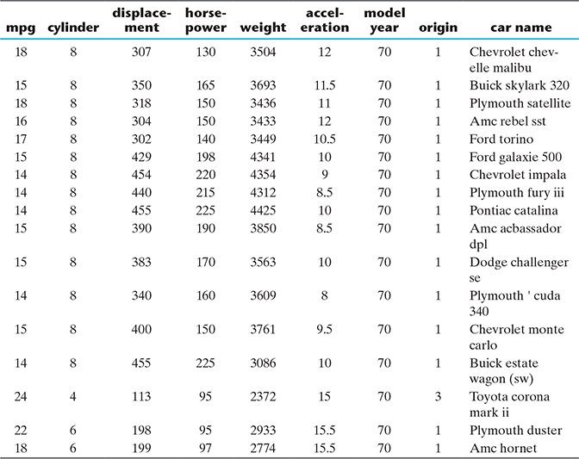
Auto MPG data set available in the UCI repository: a snapshot of the first few rows of the data set.

Slide 28
Options available
Since the attributes ‘cylinders’ or ‘origin’ have a small number of possible values, one may prefer to treat it as a categorical or qualitative attribute and explore in that way.

Slide 29
Basic statistical Description of data
Measuring the central tendency
  Mean, Median, Mode
Measuring the Dispersion of Data
  Range, Quartiles, Variance, Standard Deviation, and Interquartile Range
Five-Number Summary, Boxplots, and Outliers

Slide 30
Basic statistical Description of data
Graphic Displays of Basic Statistical Descriptions of Data
  Quantile Plot, Quantile–Quantile Plot, Histograms, Scatter Plots and Data Correlation

Slide 31
Understanding central tendency
To understand the nature of numeric variables, we can apply the measures of central tendency of data, i.e.
  mean and median.
In statistics, measures of central tendency help us understand the central point of a set of data.
Mean, by definition, is a sum of all data values divided by the count of data elements.

Slide 32
Understanding central tendency
Median, on contrary, is the value of the element appearing in the middle of an ordered list of data elements.
If we consider the 5 data elements, the ordered list would be – 21, 34, 67, 89, and 96.
Since there are 5 data elements, the 3rd element in the ordered list is considered as the median.
  Hence, the median value of this set of data is 67.

Slide 33
Understanding central tendency
why two measures of central tendency
  Mean is likely to get shifted drastically even due to the presence of a small number of outliers.
  If we observe that for certain attributes the deviation between values of mean and median are quite high, we should investigate those attributes

Slide 34
Understanding data spread
If a large deviation between mean and median
  To drill down more, we need to look at the entire range of values of the attributes,
  may be too vast to review manually. So we will take a granular view of the data spread in the form of
    Dispersion of data
    Position of the different data values
Dispersion of data
  attribute values are quite concentrated around the mean
  attribute values are extremely spread out

Slide 35
To measure the extent of dispersion of a data
  the variance of the data is measured.
Larger value of variance or standard deviation indicates more dispersion in the data and vice versa.

Slide 36
Measuring data value position
When the data values of an attribute are arranged in an increasing order,
  median gives the central data value, which divides the entire data set into two halves.
  Similarly, if the first half of the data is divided into two halves so that each half consists of one-quarter of the data set, then that median of the first half is known as first quartile or Q₁.
  In the same way, if the second half of the data is divided into two halves, then that median of the second half is known as third quartile or Q₃.
  The overall median is also known as second quartile or Q₂.
  So, any data set has five values - minimum, first quartile (Q1), median (Q2), third quartile (Q3), and maximum.

Slide 37
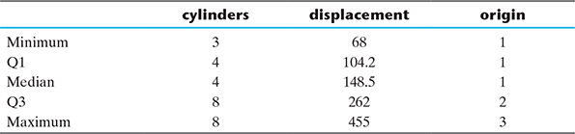
Attribute value drill-down for Auto MPG

Slide 38
Measuring data value position
For the attribute ‘displacement’, we can see that
  the difference between minimum value and Q1 is 36.2 and
  the difference between Q1 and median is 44.3.
  the difference between median and Q3 is 113.5 and
  the difference between Q3 and the maximum value is 193.
In other words, the larger values are more spread out than the smaller ones.
This helps in understanding why the value of mean is much higher than that of the median for the attribute ‘displacement’.

Slide 39
Measuring data value position
Quantiles refer to specific points in a data set which divide the data set into equal parts or equally sized quantities.
There are specific variants of quantile, the one dividing data set into four parts being termed as quartile.
Another such popular variant is percentile, which divides the data set into 100 parts.

Slide 40
Exploring numerical data
However, we still cannot ascertain whether there is any outlier present in the data.
There are two most effective mathematical plots to explore (visualize) numerical data
  box plot and histogram.

Slide 41
Types of data that can be mined
Flat Files
Relational Databases
Data Warehouse
Transactional Databases
Multimedia Databases
Spatial Databases
  used to describe any data related to or containing information about a specific location on the Earth’s surface.

Slide 42
Time Series Databases
  a sequence of data points collected over an interval of time.
  Weather data, Rainfall measurements, Temperature readings, Heart rate monitoring (EKG), Brain monitoring (EEG), Quarterly sales, Stock prices
World Wide Web(WWW)

